Slide 1







BOMBERMAN
2022.12.14

Slide 2


SUMMARY
STORY
PROJECT PRESENTATION AND ARCHITECTURE
DEMONSTRATION
HOW TO PLAY
BONUSES

Slide 3

STORY

Slide 4
PROJECT PRESENTATION AND ARCHITECTURE

Slide 5
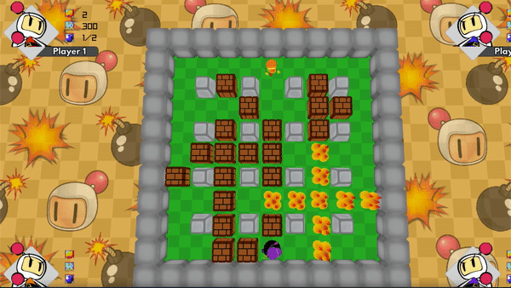




PROJECT PRESENTATION
REPRODUCTION OF THE GAME BOMBERMAN
MADE IN C++ WITH THE 3D RAYLIB LIBRARY
CUSTOMIZABLE MAP
MULTIPLAYER OR AGAINST REAL PLAYERS (FROM 1 TO 4 PLAYERS)

Slide 6

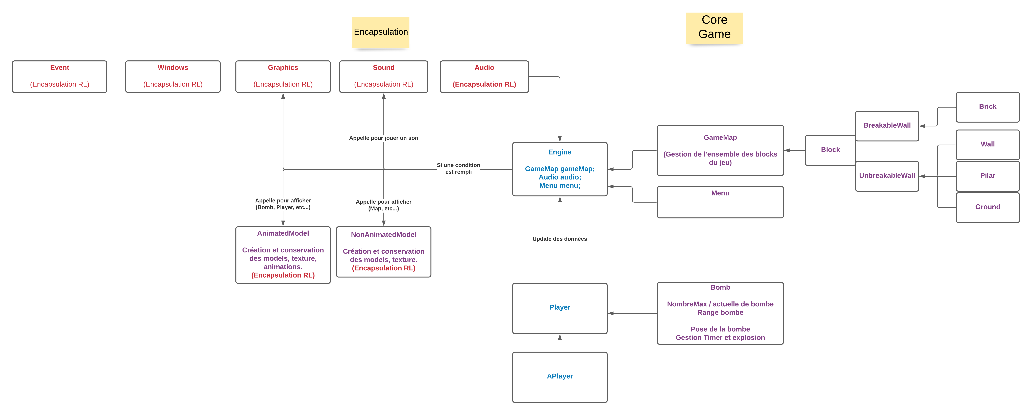
ARCHITECTURE

Slide 7
DEMONSTRATION
DEMONSTRATION

Slide 8
DEMONSTRATION
HOW TO PLAY

Slide 9
HOW TO PLAY
Z Q S D to move the player 1
SPACE to drop a bomb
E S D F to move the player 2
R to drop a bomb

Slide 10
BONUS
BONUSES

Slide 11
BONUSES
Collision detection
Animations
Usage of an open source library (Raylib)
Project uploaded to Github

Slide 12



THANK YOU!

